Slide 1
Benchmarking SHA-2/ SHA-3 on MicroBlaze
By: Michael Yen, Michael Rosales, Nathaniel Case, and Noah Mendoza

Slide 2
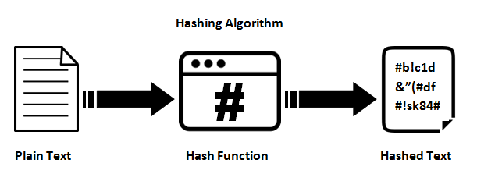
What This Presentation Discusses
Purpose: Benchmark SHA-2 and SHA-3 on MicroBlaze in constrained environments.
Why MicroBlaze? Customizable, ideal for embedded systems.
Metrics: Execution time, throughput, energy.
Insights: Efficiency vs. security trade-offs.
Impact: Informs secure algorithm selection.

Slide 3
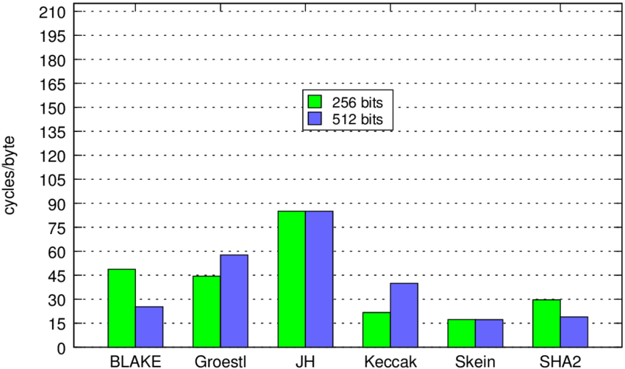
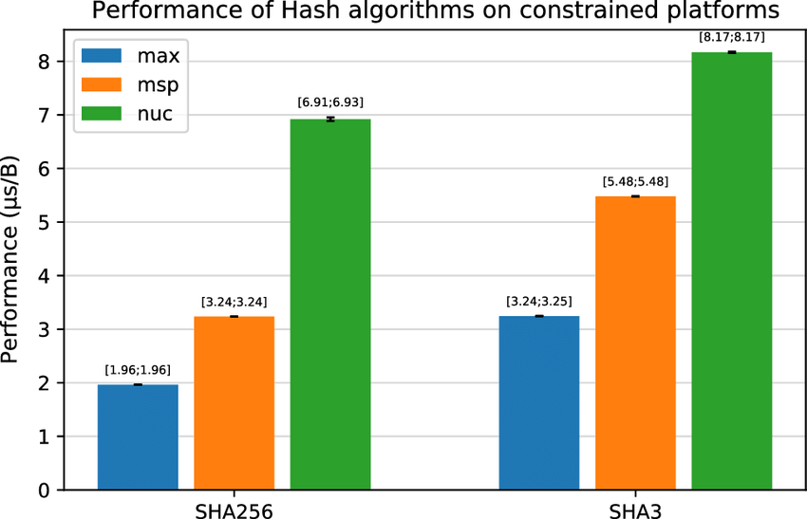
Motivations
Relevance: SHA-2/SHA-3 ensure secure communication and data integrity.
Need: Comparison driven by new cryptographic threats.
Focus: Constrained systems like IoT and CubeSats.
MicroBlaze: Customizable and ideal for benchmarking.
Impact: Balances efficiency and security insights.

Slide 4
State of the Art Technology Relating to This
SHA-2: Efficient and widely used for secure communication, including digital signatures.
SHA-3: Enhanced security with sponge construction, resistant to physical attacks.
Bitcoin: SHA-256 is the primary hashing algorithm for mining and transactions.
IoT and Cloud Systems: SHA-3 is used in IoT devices, while SHA-2 and SHA-3 are integrated into cloud providers (AWS, Google Cloud, Azure).
MicroBlaze: Benchmarks provide insights into performance in constrained environments.

Slide 5
System and Setup
Hardware: Nexys A7-100T FPGA with MicroBlaze processor.
01
Processor Configuration:
02
32-bit architecture, clocked at 100 MHz.
Instruction and data caches enabled.
DDR2 SDRAM added for larger datasets.
Peripherals:
03
AXI UARTLite for input/output.
AXI Timer for measuring cycles.
GPIO for debugging.
Software:
04
Open-source SHA-2 and SHA-3 implementations.
Xilinx Vitis for development and benchmarking.

Slide 6
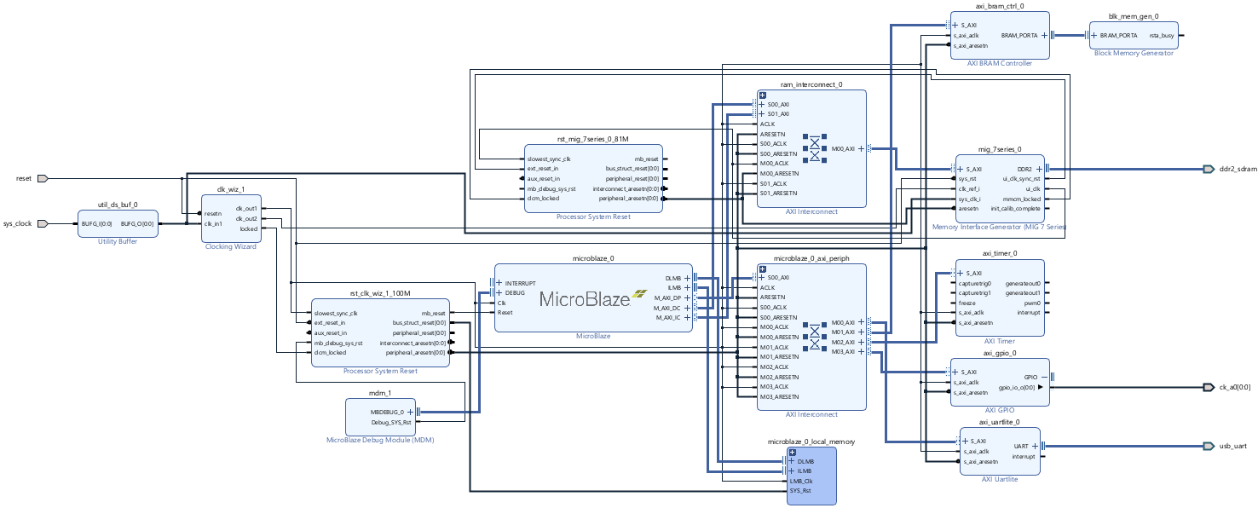

Slide 7
Performance Analytics
Test Cases: Functional tests, edge cases, and performance tests (1 KB and 1 MB inputs).
Metrics Analyzed:
Execution time (clock cycles).
Throughput (bytes per second).
Energy consumption (microjoules).
Tools Used: AXI Timer for execution time and calculated energy based on system power.
Key Inputs: Validated with the string "1234567890" and other edge cases.

Slide 8
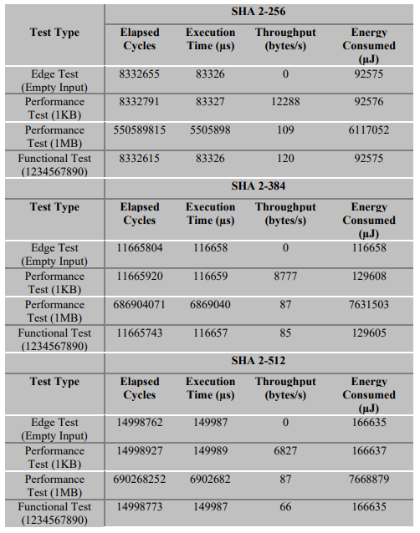
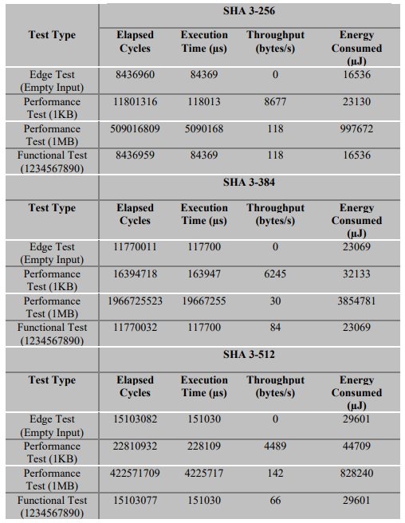
SHA 2-256 Vs. SHA 3-256
Execution Time: SHA 2-256 is faster; SHA 3-256 is slower due to sponge construction.
Throughput: SHA 2-256 achieves 12,288 bytes/s (1 KB), SHA 3-256 only 8,677 bytes/s.
Energy: SHA 2-256 is more efficient; SHA 3-256 uses more energy for larger inputs.
Conclusion: SHA 2-256 is better for efficiency, SHA 3-256 for stronger security.

Slide 9
SHA 2-384 Vs. SHA 3-384
Execution Time: SHA 2-384 is faster; SHA 3-384 slower for larger inputs.
Throughput: SHA 2-384: 8,777 bytes/s (1 KB), SHA 3-384: 6,245 bytes/s.
Energy: SHA 2-384 is more efficient; SHA 3-384 uses more energy.
Conclusion: SHA 2-384 excels in efficiency, SHA 3-384 in security.

Slide 10
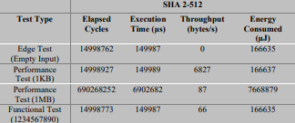
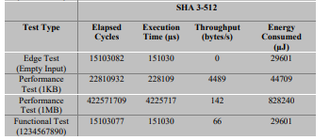
SHA 2-512 Vs. SHA 3-512
Execution Time: SHA 2-512 is faster; SHA 3-512 is slower.
Throughput: SHA 2-512: 6,827 bytes/s; SHA 3-512: 4,489 bytes/s.
Energy: SHA 2-512 uses less energy; SHA 3-512 uses more for large inputs.
Conclusion: SHA 2-512 excels in efficiency; SHA 3-512 offers stronger security.

Slide 11
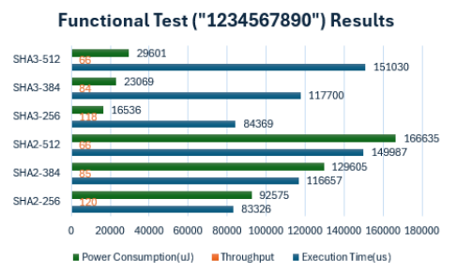
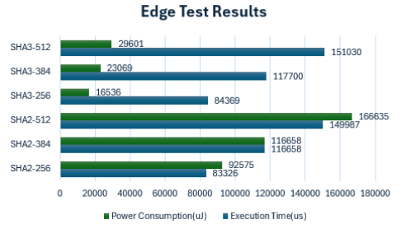
Edge Test and Functional Test

Slide 12
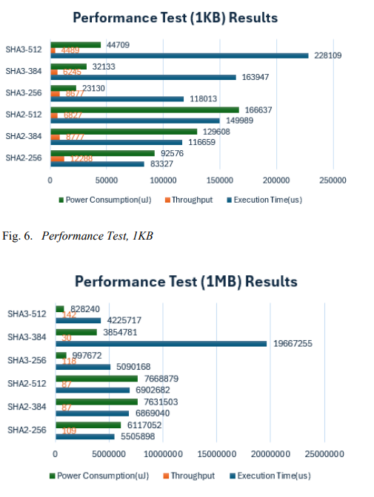
Performance Tests (1KB/1MB)

Slide 13
Conclusion
Hash Length: SHA-2 and SHA-3 outputs:
256-bit: 64 chars, 384-bit: 96 chars, 512-bit: 128 chars.
Performance: SHA-2 is faster; SHA-3 offers stronger security.
Energy: SHA-2 is efficient for small inputs; SHA-3 for larger ones.
Trade-offs: SHA-2 suits constrained systems; SHA-3 fits high-security needs.

Slide 14
Future Works
Processor Comparison: Test algorithms on other processors, such as Intel Nios II or RISC-V.
Input Variability: Use larger, randomized, or real-world datasets (e.g., logs, sensor data).
Compiler Optimizations: Analyze performance using optimization flags like -O3.
Hardware Acceleration: Implement and compare hardware-accelerated versions on FPGA logic.
Power Profiling: Use precise tools to refine energy consumption analysis.

